Slide 1
MOB DEVICES VUL & MITIGATION
Lesson 61
Intro : Mob Device Security
Last Updation Dt : 08 Jan 25

Slide 2

LESSON PREVIEW
Intro to Mob OS Arch
File Structure
Versions
Security Features
Current Mkt Ldrs
Comparison of Apps
Tracking Vulnerabilites in Smart Phs

Slide 3
PD 1 : MOB OS ARCHITECTURE & FILE STRUCTURE

Slide 4
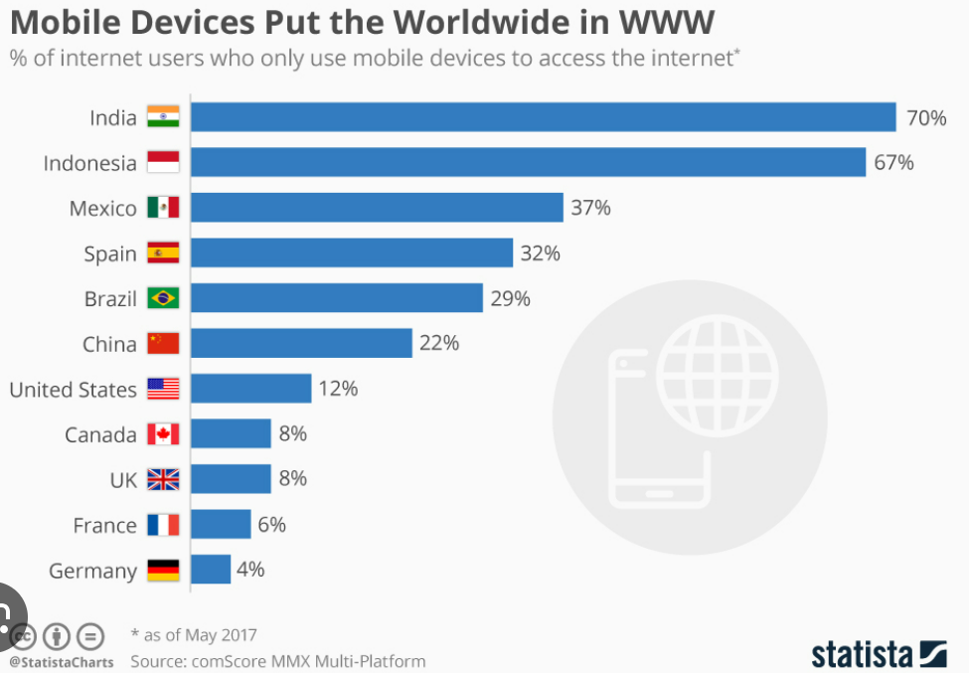

IMP OF MOB DEVICE SECURITY
80% of Internet users access the web via mob.
Threats. Malware, unauthorized access, data leaks,etc

Slide 5
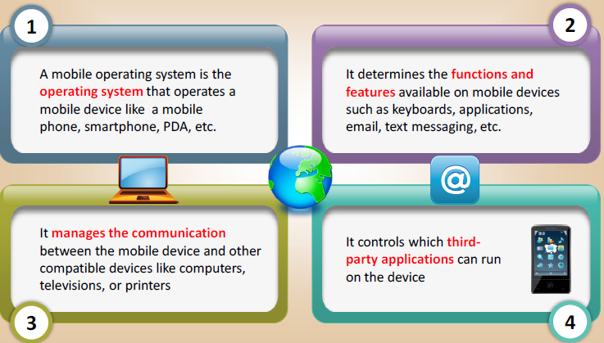
MOB OS

Slide 6
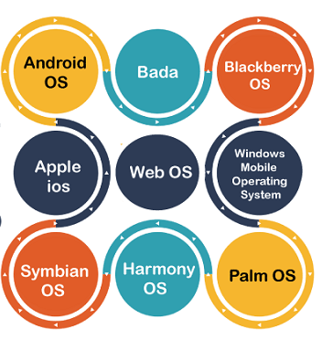
OVERVIEW OF MOB OS ARCHITECTURE
Definition. An OS specifically designed for mob devices like smartphones, tablets, smartwatches, and smartglasses.
Distinction from Laptop OS.
Traditional laptop OS are not usually considered "mobile" despite their portability.
Initially devp for desktop cmptrs and lack features specifically designed for mob use.
Blurring Lines. Distinction betn mobile and other OS has become less clear in recent years.

Slide 7
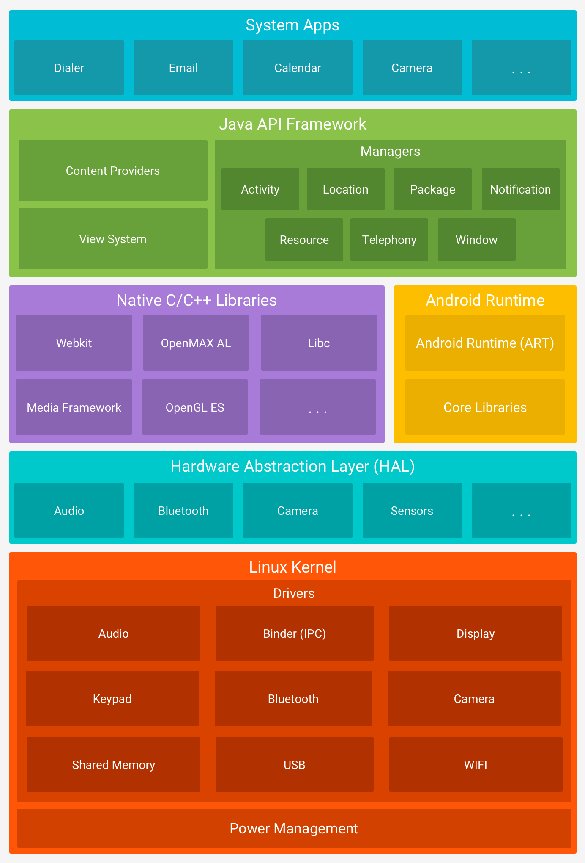
ANDROID OS : ARCHITECTURE
SYS APPS
JAVA API FRAMEWORK
NATIVE C/ C++ LIBRARIES | ANDROID RUNTIME
HARDWARE ABSTRACTION LAYER
LINUX KERNEL

Slide 8
COMPONENTS OF ANDROID OS: KERNEL
Linux Kernel as Foundation. Android's core is built upon the Linux kernel.
Security Benefits. Utilizing the Linux kernel provides Android with robust security features.
Hardware Driver Devp. Use of Linux simplifies hardware driver devp for device manufacturers.

Slide 9
COMPONENTS OF ANDROID OS: HAL
Hardware Abstraction Layer (HAL) provides std interfaces to expose device hardware capabilities to the higher-level Java API framework.
Consists of multiple library modules, for specific types of hardware component (e.g., camera, Bluetooth module).

Slide 10
COMPONENTS OF ANDROID OS: ANDROID RUNTIME
Exec envt handling the allocation and mgt of resources like memory and CPU time.
Written to run multiple virtual machines on low-memory devices.
Notes:
Imagine your phone's apps as tiny robots. The Android Runtime is like their secret headquarters.
It gives them a place to live and work: The Runtime provides the environment where apps can exist and function.
It manages their resources: It makes sure they have enough power and memory to do their jobs.
It makes them run smoothly: The Runtime helps apps start quickly and run smoothly, just like a well-oiled machine.

Slide 11
COMPONENTS OF ANDROID OS: NATIVE C/C++ LIBRARIES
ART and HAL, are built from native code that requires native libraries written in C and C++.
Provides Java framework APIs to expose the functionality of some of these native libraries to apps.
Notes:
Imagine your phone's apps as tiny robots. The Android Runtime is like their secret headquarters.
It gives them a place to live and work: The Runtime provides the environment where apps can exist and function.
It manages their resources: It makes sure they have enough power and memory to do their jobs.
It makes them run smoothly: The Runtime helps apps start quickly and run smoothly, just like a well-oiled machine.

Slide 12
COMPONENTS OF ANDROID OS: JAVA API FRAMEWORK
Form the building blocks reqd to create Android apps .
Simplifying the reuse of core, modular system components and services.
Notes:
Imagine your phone's apps as tiny robots. The Android Runtime is like their secret headquarters.
It gives them a place to live and work: The Runtime provides the environment where apps can exist and function.
It manages their resources: It makes sure they have enough power and memory to do their jobs.
It makes them run smoothly: The Runtime helps apps start quickly and run smoothly, just like a well-oiled machine.

Slide 13
COMPONENTS OF ANDROID OS: SYS APPS
Set of core apps.
Used for email, SMS messaging, calendars, internet browsing, contacts, and more.
Function both as apps for users and to provide key capbs that developers can access from their own app.
Notes:
Imagine your phone's apps as tiny robots. The Android Runtime is like their secret headquarters.
It gives them a place to live and work: The Runtime provides the environment where apps can exist and function.
It manages their resources: It makes sure they have enough power and memory to do their jobs.
It makes them run smoothly: The Runtime helps apps start quickly and run smoothly, just like a well-oiled machine.

Slide 14
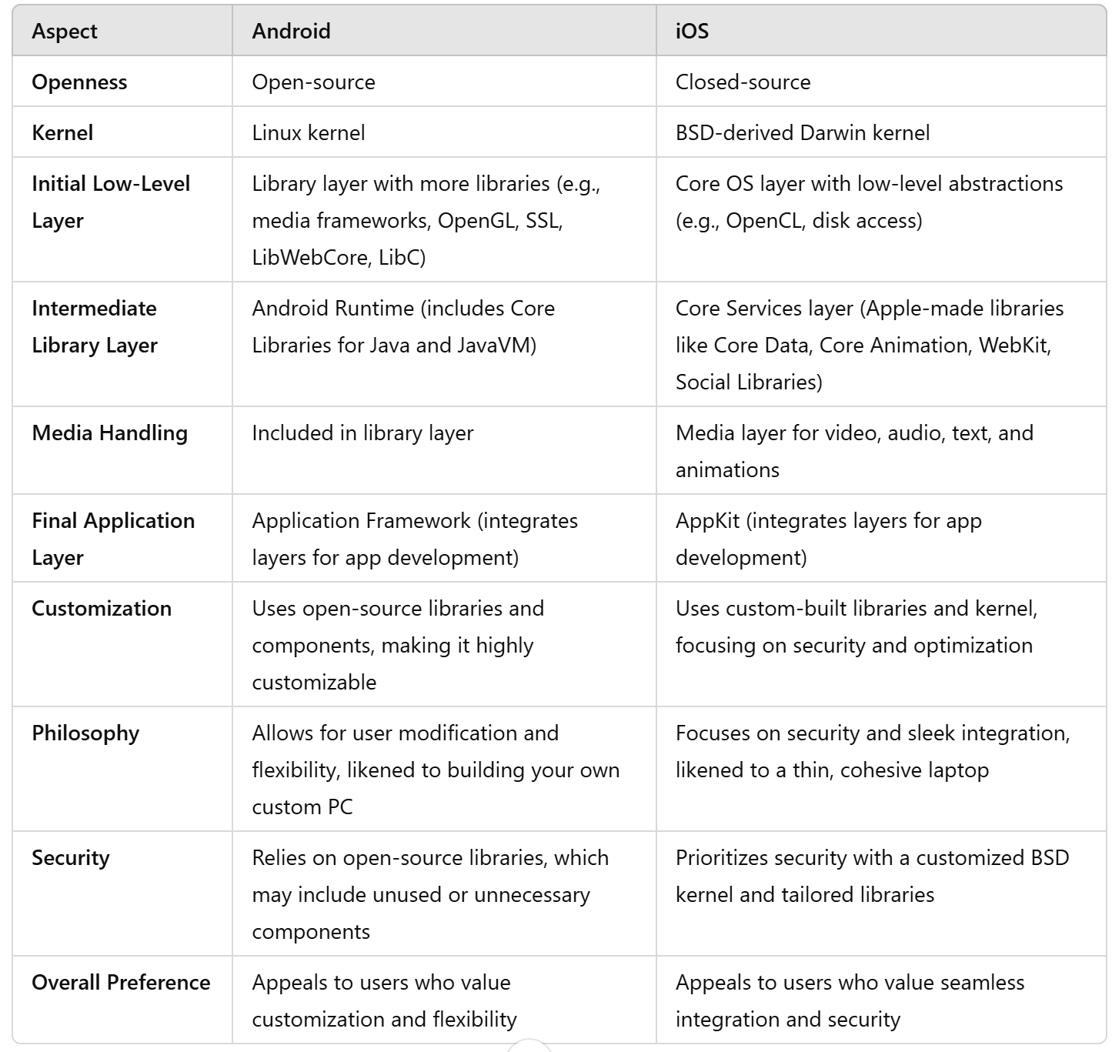
ANDROID VS iOS ARCHITECTURE

Slide 15
INTRO TO FILE STRUCTURE
Android uses a disk-based file sys.
Storage Areas.
Internal Storage.
Built-in, non-volatile memory.
Referred to as permt storage.
External Storage refers to removable memory, such as an SD card.

Slide 16
INTRO TO FILE STRUCTURE
Android File Sys Hierarchy.
Usually six main partitions incl fwg :-
/boot - Consists of the Android kernel and the ramdisk.
/system - Accommodates the entire Android OS.
/recovery - Designed for backup and can be considered the alternative boot option or partition
/data - Consists of all of the user’s data
/cache - Stores the frequently accessed app data and components
/misc - Contains all the misc system settings
Additionally, /sdcard and /sd-ext for ext Android smartphone.

